Slide 1

Applying Data Science into PK/PD Concepts for Individualized Therapy
Cancer Bioinformatics Data Science Bootcamp, 2025

Slide 2
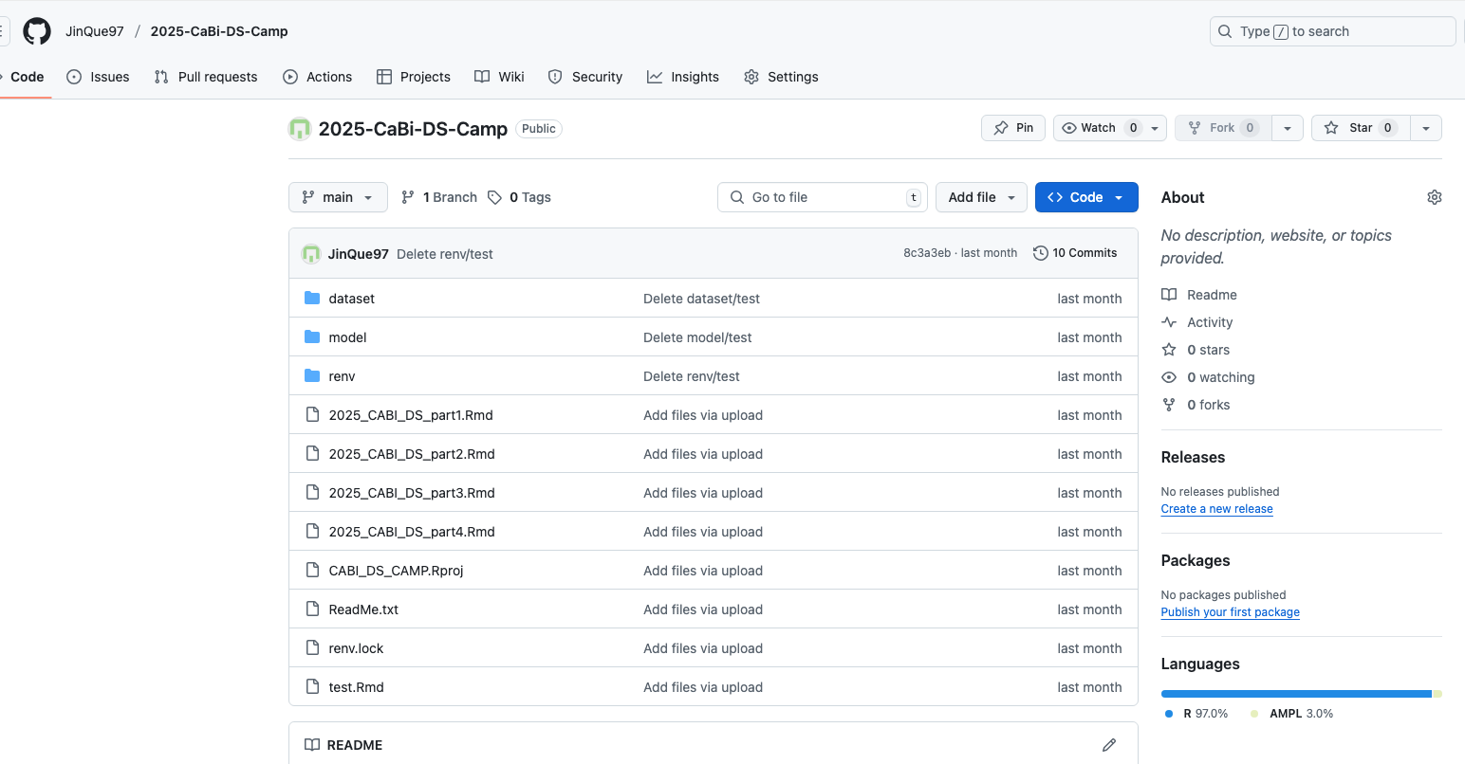
Materials
Use this link for now: https://posit.cloud/content/10469544
You can download a copy here: https://github.com/JinQue97/2025-CaBi-DS-Camp

Slide 3
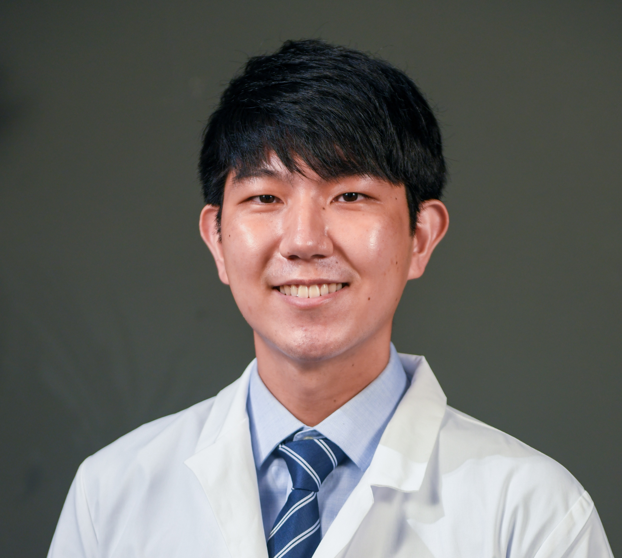
How I got here
Jin Gyu Kim
Entered Pharmacy School (2021)
First time learning about pharmacology — the study of drugs
Introduced to basic data analysis with RStats
Became more interested in drug behavior (Pharmacokinetics & Pharmacodynamics)
Discovered Pharmacometrics
A field that combines pharmacology with data analytics
Joined Graduate School (2024)
Exploring exciting topics like:
Drug development
Machine learning
Clinical trial design
Personalized drug therapy

Slide 4
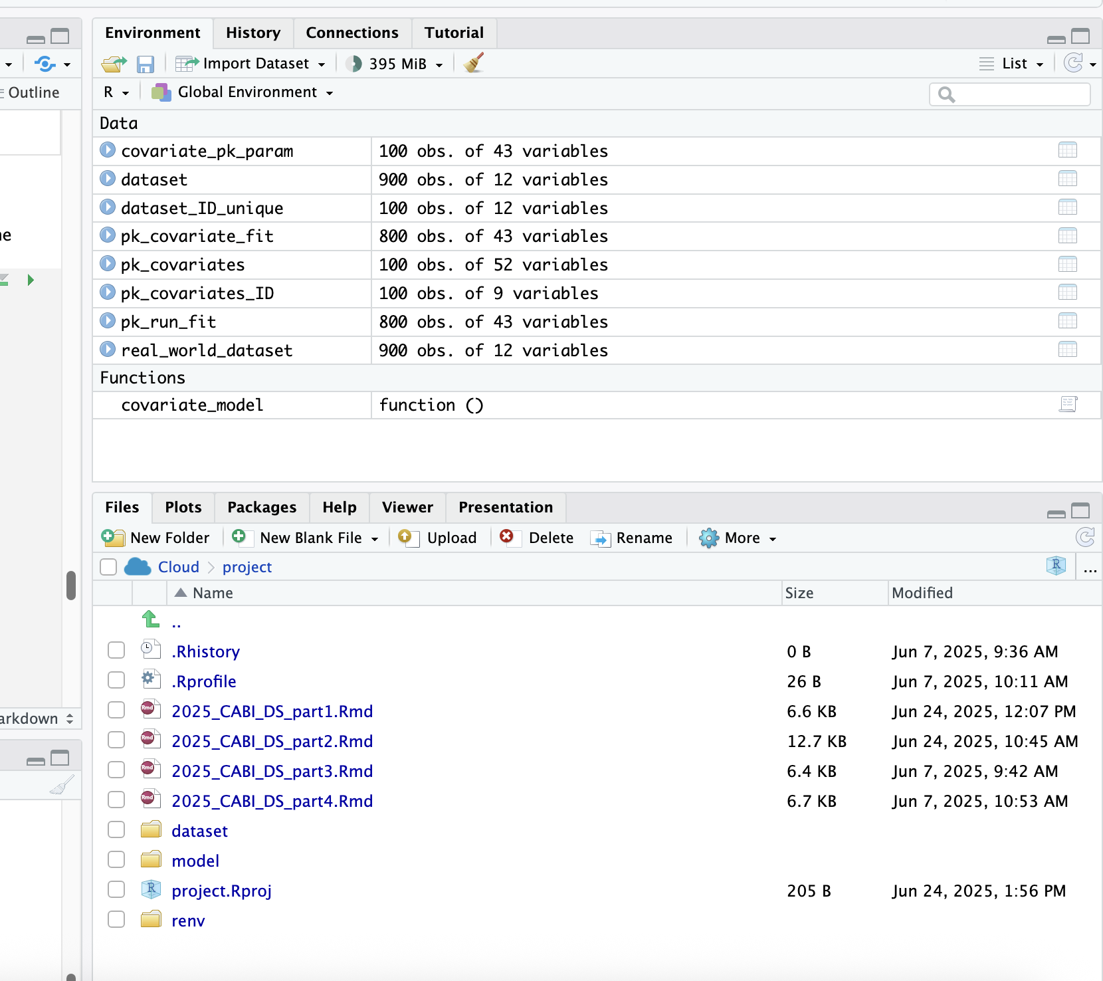
Course sessions (Tue & Wed)
Basic concepts of PK/PD Data Analysis and Data Visualization
Part 1 – Dealing Real World Data and Basic Data Visualization
Showcase on developing individualized drug therapy with KRT-232 drug
Part 2 – Obtaining individual PK profiles and identifying demographic factor driving PK
Part 3 – PK/PD relationship and PD model parameter estimation
Part 4 – Simulation Run and Precision dosing

Slide 5
Part 1 – Basic concepts of PK/PD Data Analysis and Data Visualization

Slide 6
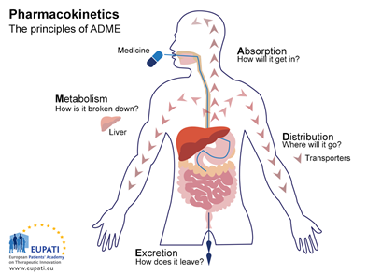
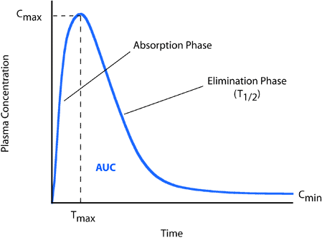
Once you swallow the pill, it travels into your body We describe these steps with conc-time curve in our blood
Recall from Dr. Phelp’s lecture:

Slide 7
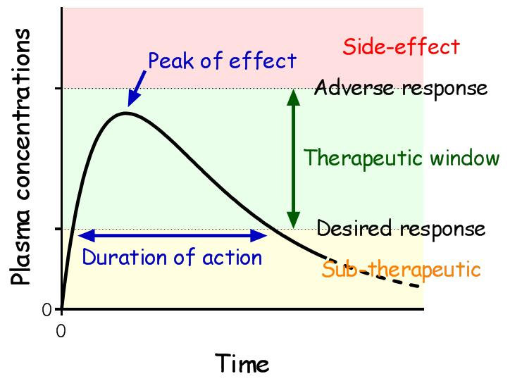
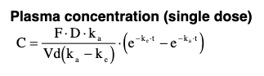
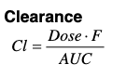
In pharmacokinetics world…
Some drug’s efficacy and safety can be characterized by therapeutic range
If overshoot – Toxic
If undershoot – It doesn’t work
Questions to place in therapeutic window:
How much?
How often?
How long?
With PK profiles (Volume and Clearance), we can draw (describe) a conc-time curve (Drug behavior)!

Slide 8
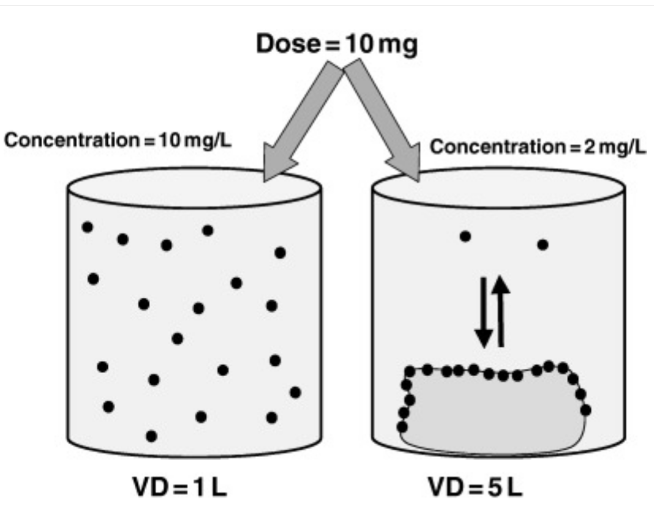
Volume
Think about your body is a bucket
Unit: Volume (L or mL)
Generally, small body will have a small volume, and big body will have a large volume
Everyone’s volume(bucket size) is different
We consider this fact to not to overshoot (Toxicity) or undershoot (Sub-therapeutic)

Slide 9
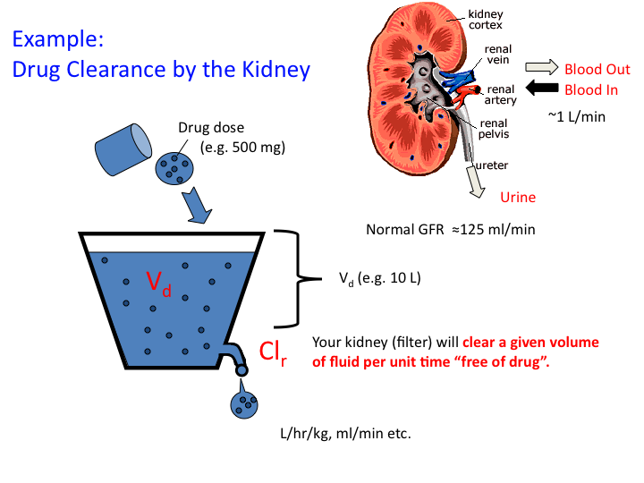
Clearance
Volume of plasma or blood that is completely cleared of a drug per unit of time
Unit: Volume (L or mL) / Time (min or hours)
Liver or Kidney are key organs to clear the drug out
And we know that everyone’s clearance (liver or kidney function) is different at different time
Generally older population will have decreased function
When you are critically ill
Some drugs are genetically dependent

Slide 10
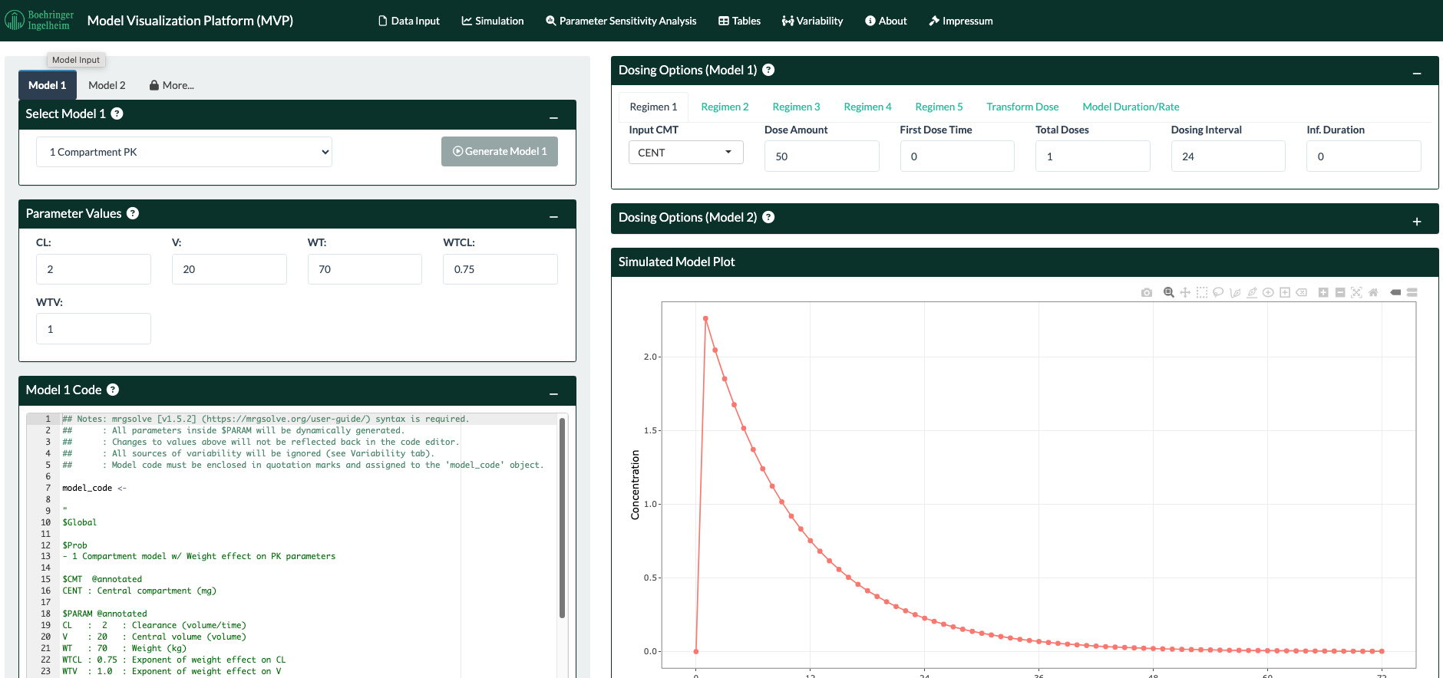
Check this out
https://mvp.boehringer-ingelheim.com/

Slide 11



Data is gold and we have mining tools
From clinical trials and animal studies, we get numerous samples across individuals (Data)
We turn data into PK/PD knowledge (i.e. Volume, Clearance) -> Clinical Pharmacology/Pharmacometrics
With the help from data science tools (RStats), we visualize and analyze to make scientific/clinical decisions (Data Science)

Slide 12
Hands-on activity - Part 1

Slide 13
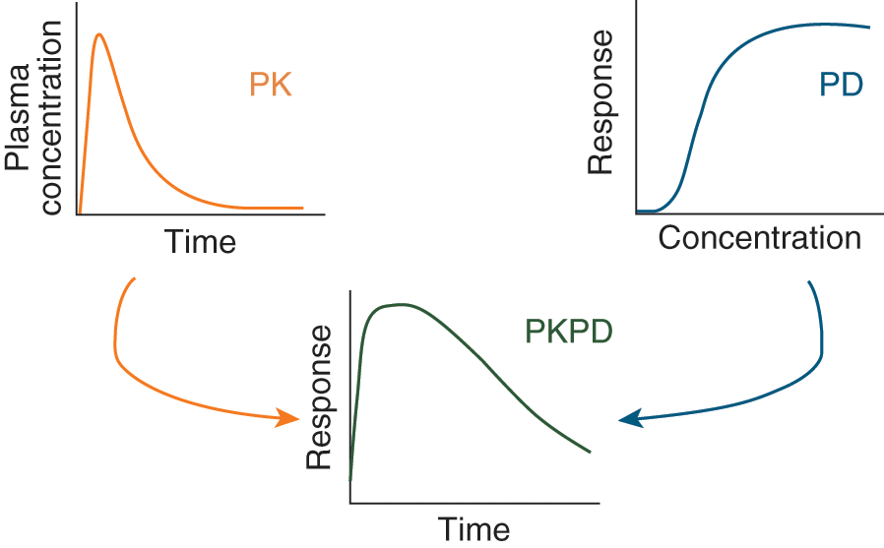
Pharmacodynamics (PD) – Tomorrow
PD - The drug works in our body
This could be characterized by response (measurement) over time
For example:
Tylenol -> How long does it takes to decrease the body temperature? (30 mins? 1 hour? Day?)
Blood pressure meds -> How much does the drug decrease the blood pressure (Decrease by 10/5? 20/10? 30/20?)

Slide 14
Before we start: Questions?

Slide 15
Take home points
Visualization is a powerful tool to interpret the data and aid in decision making for data scientists.
There are always uncertainties in the data collected so we do our best to deal with this in data analysis.
It is important to define the PK/PD relationship in drug discovery to have confidence in the drug

Slide 16
Part 2 – Obtaining individual PK profiles and identifying demographic factors driving PK

Slide 17
Looking Back at What We Covered
Everyone’s volume(bucket size) is different
Everyone’s clearance (liver or kidney function) is different
If we know their PK profiles (V and CL) then we can answer:
How much/How often/How long to make sure we place in therapeutic window?

Slide 18
Real World Case
KRT-232 showed its promising novel cancer therapy
However, some patients fully responded to this drug while others didn’t have any improvements.
Further studies have found there is a relationship between the treatment outcome and MIC-1 concentration in response to the drug
Macrophage Inhibitory Cytokine-1 (MIC-1) is a response measure to KRT-232 drug
KRT-232
MIC-1
Treatment: Success of Fail
Pharmacokinetics: Everyone’s exposure (V, CL) is different
Pharmacodynamics:
MIC-1 concentration is different in response to KRT-232 exposure
MIC-1 concentration above:
Toxic
MIC-1 concentration below:
No treatment effect
Goal: Find individualized dosing strategy to ensure patient safety and treatment effect

Slide 19
KRT-232 dosing strategy
30-day treatment course
At Day 1, 100 Patients take KRT-232 1 tablet (60,000 μg -> 60 mg dose) and we collected PK (Drug concentration over time) and PD (MIC-1 concentration over time) samples
Narrow therapeutic window (MIC-1 concentration: 100 – 200 mg/L)
Goal: Characterize individual exposure and MIC-1 response to build a dosing strategy for the next 29 days

Slide 20
How?
Part 2: Use KRT-232 concentration-time data to build a PK model and characterize individual exposure (KA, V, CL, etc.)
Part 3: With individual exposures, we link the MIC-1 concentration-time data to complete the PK/PD model
Part 4: Find individualized dosing strategy
4-1 We simulate the MIC-1 concentration for 30 days treatment course
4-2 Explore potential dosing strategies
How much?
How often?
How long?

Slide 21
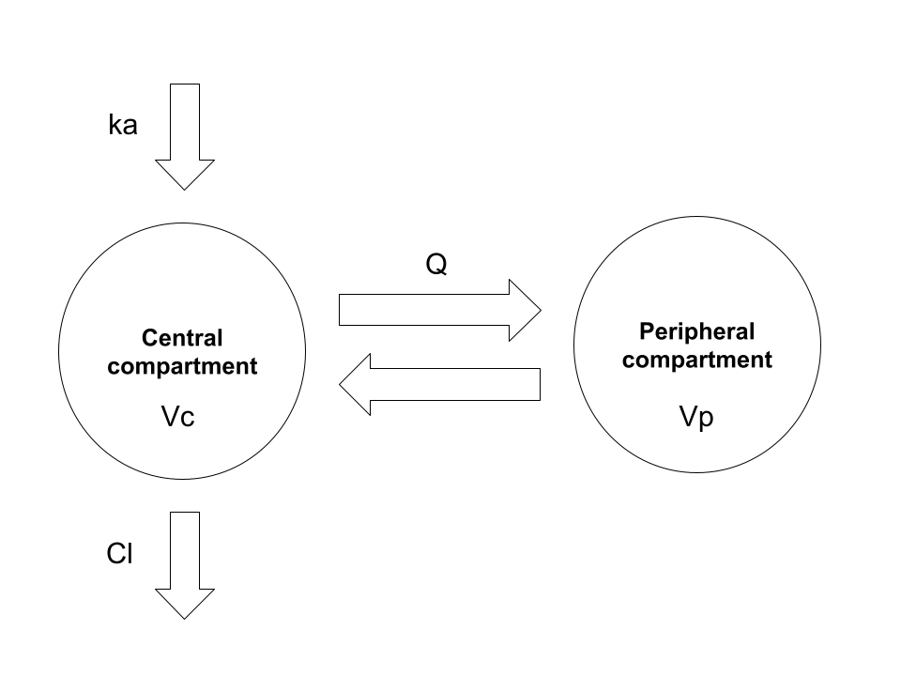
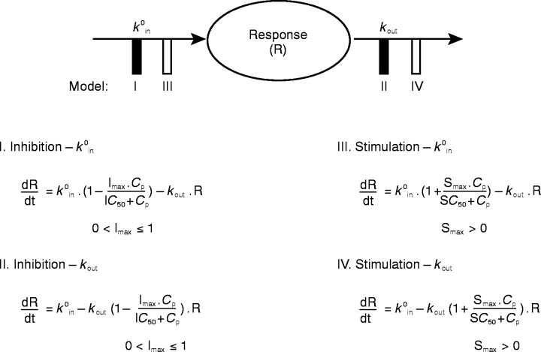
What is a model?
Model = Combination of structural (PK mathematical equations) + statistical concepts
KRT-232 Defined Model (PK and PD)
Defined Model + Measured data (KRT-232 / MIC-1 conc vs time) = predicted Individual parameter values (V and Cl) -> Parameter Estimation
PK – 2 compartment with absorption model
PD – Indirect response (Turnover) model

Slide 22
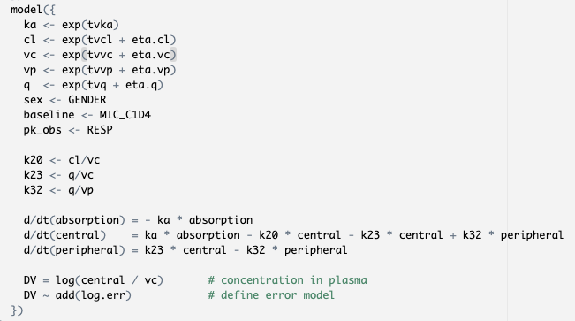
2 compartment with absorption model
PK – 2 compartment with absorption model

Slide 23
Why we visualize?
PK – 2 compartment with absorption model
Model has numerous layers of assumptions
-> There are numerous ways that it could go wrong!!
One way to find is with model diagnostics tools (i.e. Goodness-of-Fit, Simulation prediction, etc.)
Idea: You compare the prediction vs observation (read world data)
If there is skewedness or irregular distribution of the prediction vs observation, then the model doesn’t describe your data well
Always use model diagnostic tools to ensure the model captures the data well

Slide 24
Demographic features driving drug exposures
In some cases, demographic features (Age, Weight, etc.) plays a critical role in PK parameters -> covariates
These info will be integrated into dosing guidelines (i.e. weight base dose, altered kidney dose, etc.) and it is our job to find these covariates to ensure safe drug use -> covariate exploration
With individual parameters, we graph with demographic features and see if there is any patterns and we add it into our model to describe data with equations

Slide 25
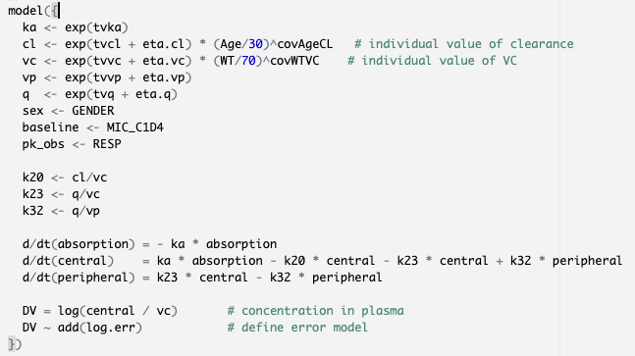
Age and Weight effect on Cl and Vc
Before
After

Slide 26
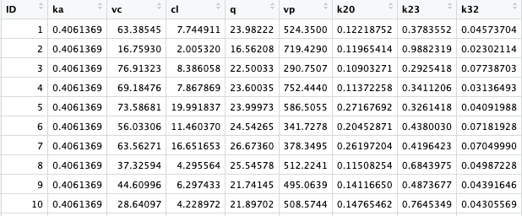
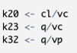
Now what we have
Individual PK parameters
Characterized 100 individual’s exposures (PK parameters – Volume, Clearance, etc.)
Next Step?
With individual exposures, we link the MIC-1 concentration-time data to complete the PK/PD model
Find individualized dosing strategy
Recall

Slide 27
Tomorrow
Basic concepts of PK/PD Data Analysis and Data Visualization
Part 1 – Dealing Real World Data and Basic Data Visualization
Showcase on developing individualized drug therapy with KRT-232 drug
Part 2 – Obtaining individual PK profiles and identifying demographic factor driving PK
Part 3 – Characterize PK/PD relationship and PD model parameter estimation
Part 4 – Simulation Run and Precision dosing

Slide 28
Questions?

